Slide 1
IPM V-type geometry parameters
22/07/2019
Simone Ferrari (simone.ferrari@polito.it)

Slide 2
Introduction
This document illustrate the geometry parameters for the V-type rotors and the key points for the geometry draw

Slide 3
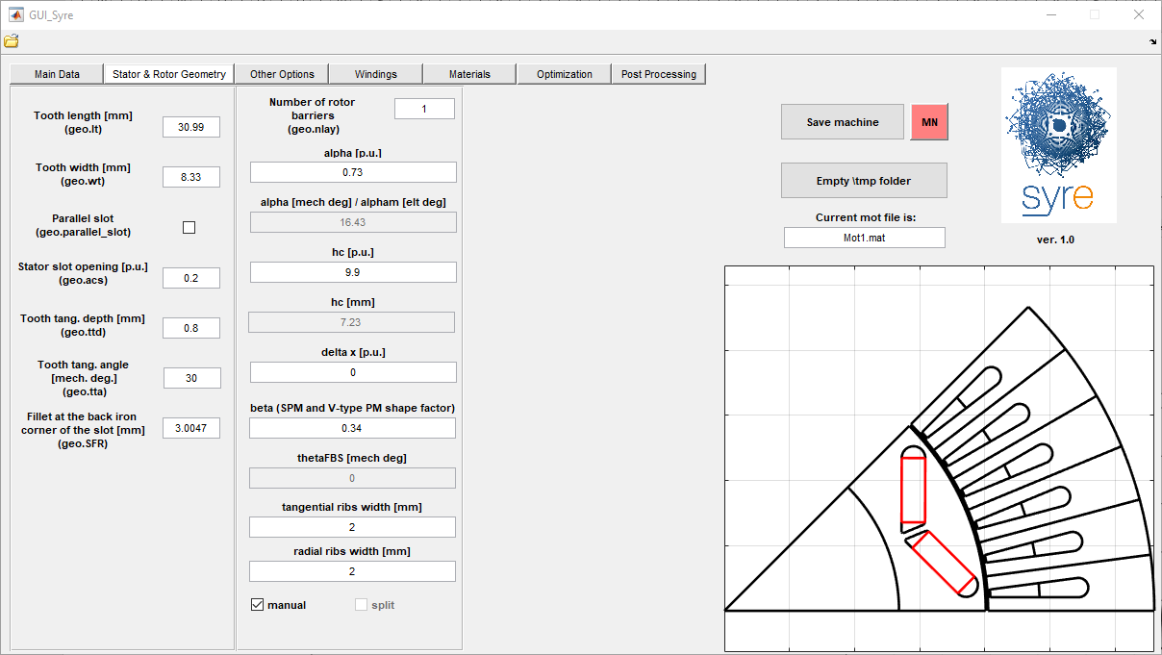
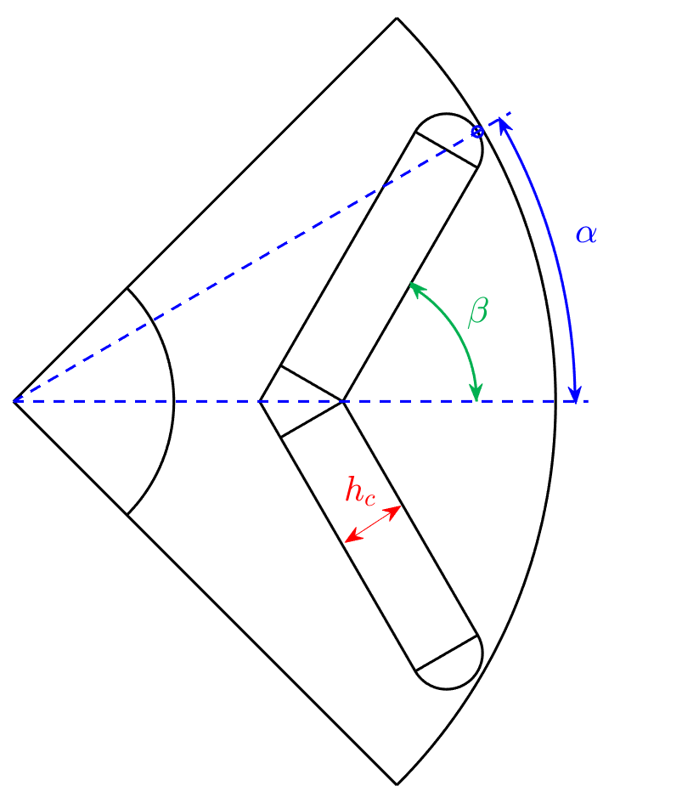
Geometry parameters
In p.u. of the pole arc
In p.u. of the airgap length
Tangential ribs:
dx=0 → round
dx=1 → constant thickness
PM shape factor in p.u.:
Beta=0 → I-type
Beta=1 → PM parallel to pole boundary

Slide 4
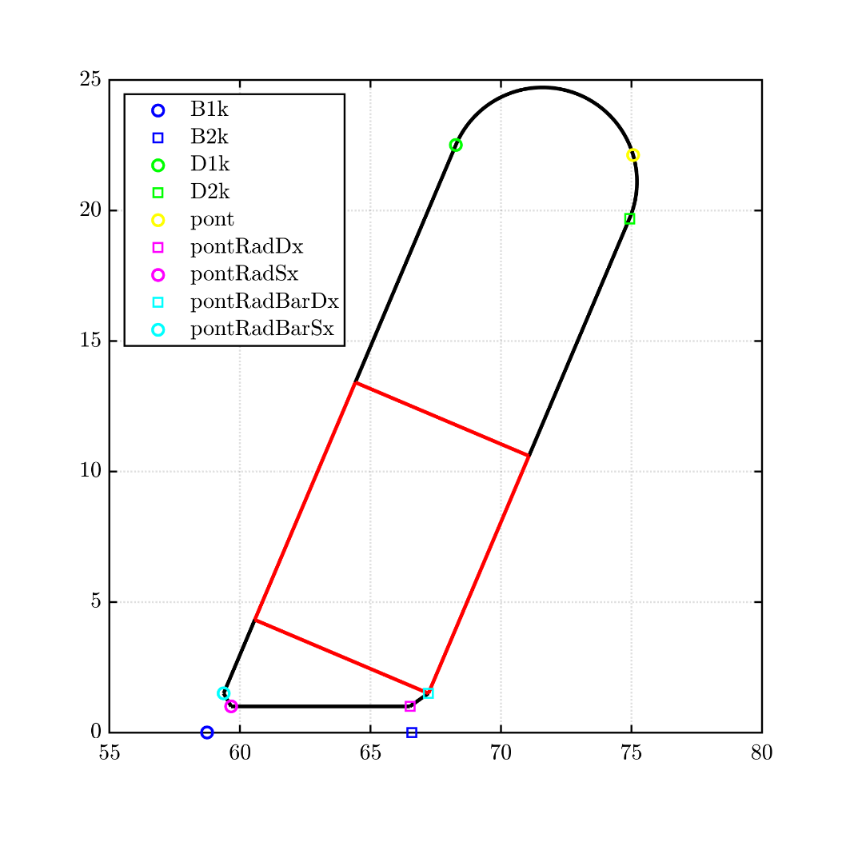
Key points – base geometry

Slide 5
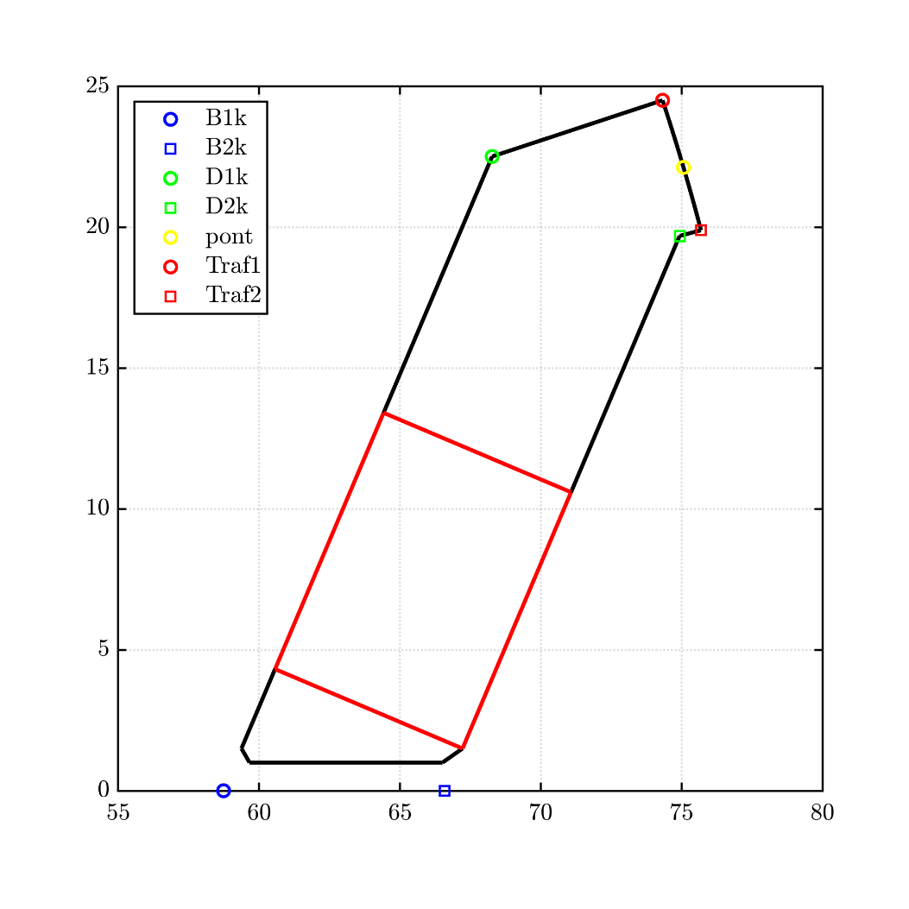
Key points – straight ribs

Slide 6
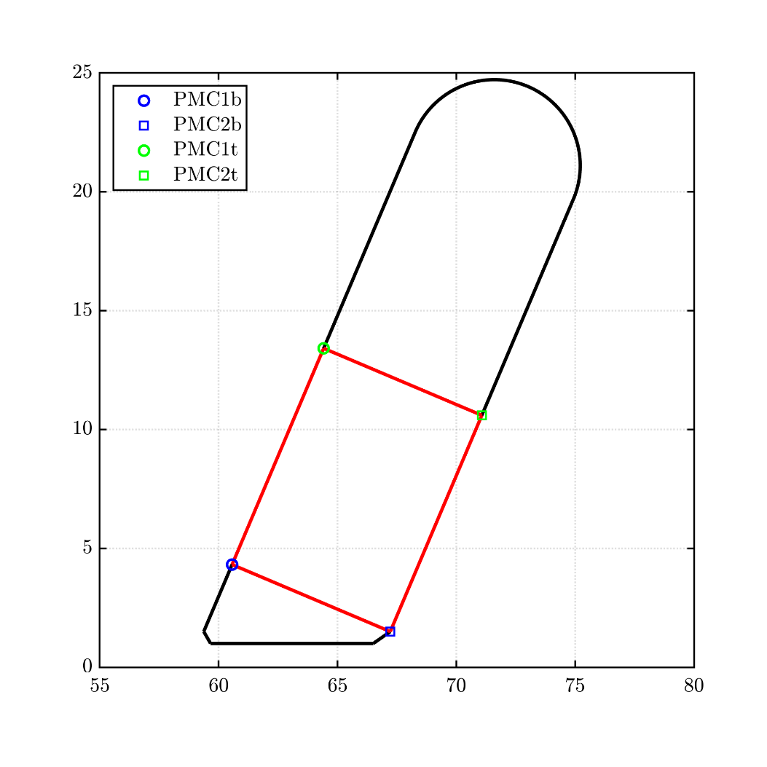
Key points – PM

